Slide 1
Route Turns and Hurdle Guidance Android App
Presented By Muhammad Farjad Ali Raza (SEU-S115-113)
Supervisor Name Sir Arshad Ali Khan
Department Of Computer Science & Information Technology
The University Of Lahore Islamabad Campus

Slide 2
Introduction
Our project is based on Android Mobile application.
The application is based on mapping and navigation.
It detects and provides information about the road e.g. turns, speed breakers etc.
Our application will help in prevention of road accident.

Slide 3
Problem Statement
Human-made abnormalities, such as speed bumps, are not always correctly labeled, can cause accidents when not identified by the drivers.
The driver may fail to notice the speed bumps in complex driving conditions especially during nights or in the foggy weather because of low visibility, which results into serious damage.

Slide 4
Objective
A project for the detection of road abnormalities (i.e., speed bumps).
This method makes use of a sensor mounted in a car & a GPS.
After having the vehicle trip through several locations, data is retrieved from the sensors & transfer this data on server so every client can utilize this data during travelling.

Slide 5
Existing system
In the existing system, it was very difficult to identify the road Bumps & in order to avoid accidents
Compatible with few devices.
No detection by any sensor.

Slide 6
Significant Impact
Earlier notify user before a speed breaker and a sharp curve
Help in prevention of road accident
Source of guidance for new drivers which are non familiar to new location

Slide 7
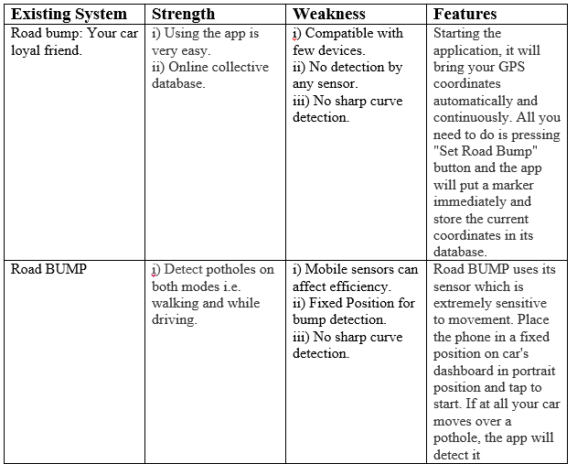
Cont.

Slide 8
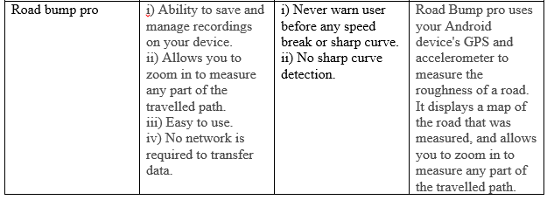
Cont.

Slide 9
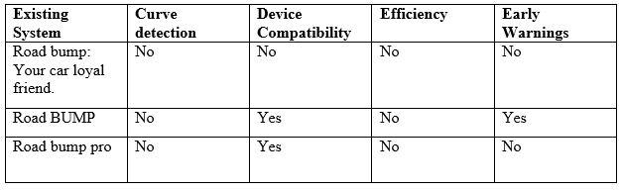
Deficiencies in existing system

Slide 10
References
[1] Takashi Furukawa. Japan 2012 “VIMS Manual. “VIMS Consortium. Nagasaki University.
[2] A.Mendis, L.Selavo, R.Zviedris, G.Kanonirs, G.Strazdins,2011 “Real Time PatholeDetection Using Android Smartphones With Accelerometer”.
[3] A.Mednis, L.Salavo, R.Zviedris, G.Kanonirs, G.Strazdins, “Towords Vehicular Sensor Networks With Android Smartphone For Road Surface”
[4] Prof.B.U.Lanjewar1, Rahul Sagar2, Rasika Pawar2, Jyoti Khedkar2, Kunal Gosavi2 “Road Bump and Intensity Detection using Smartphone Sensors ”

